Slide 1


Centre for Development of Advanced Computing (C-DAC)
Post Graduate Diploma - Embedded Systems Design
BATTERY HEALTH MONITORING SYSTEM
Guided By: Mr. Shripad Deshpande
Group Members :-
Aditya Pal (240340130003)
Akansha Prasad (240340130005)
Rahul Labade (240340130027)
Shubham Pawar (240340130046)

Slide 2

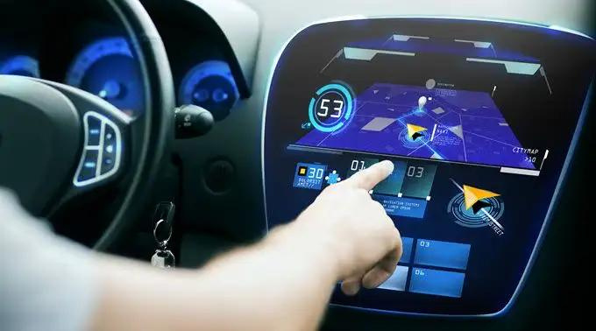
THE PROBLEM
EV market suffers as people are hesitant to buy EV due to too much technical jargons present over the dashboard So we make it simpler by calculating SOC and SOH and display on the screen.

Slide 3

THE SOLUTION
Developing a user-friendly dashboard that transforms confusing data into clear, actionable insights presented in simple language. Obtaining the voltage and current, temperature of each cell of the battery leads to exact information of battery status

Slide 4

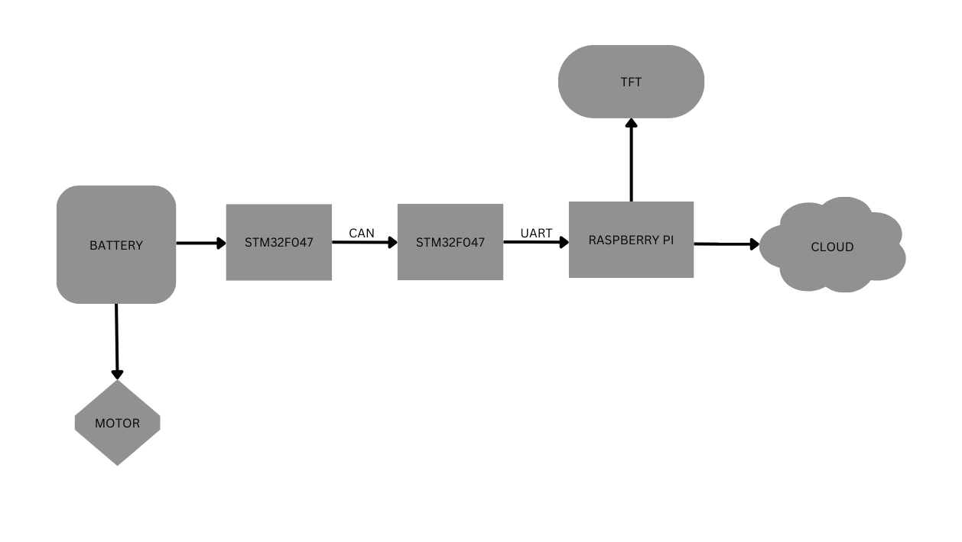
BLOCK DIAGRAM

Slide 5

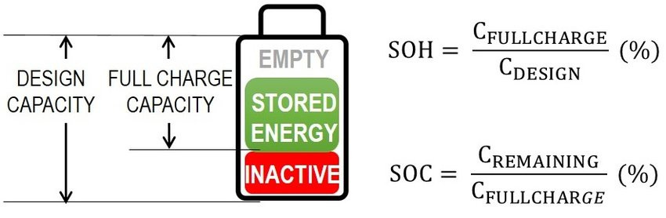
WHAT MATTERS?
SOC
SOH

Slide 6

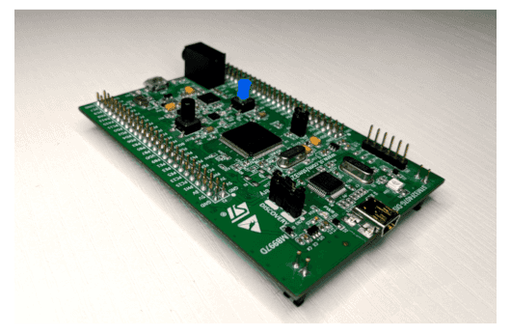
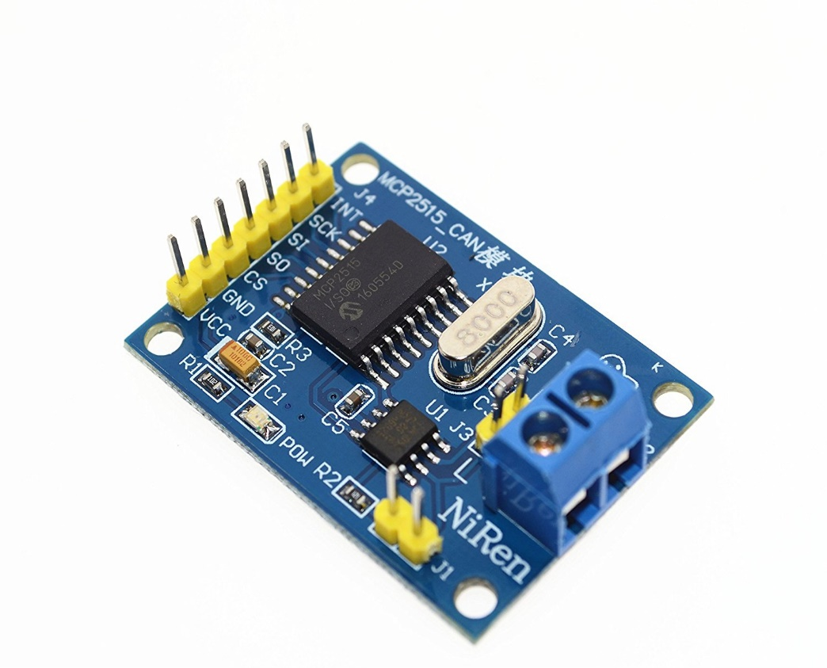
Battery to CAN
1
2
STM32F407VGT6 DISCOVERY BOARD
CAN BUS Module

Slide 7
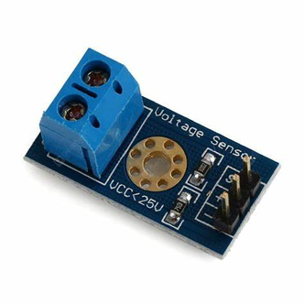
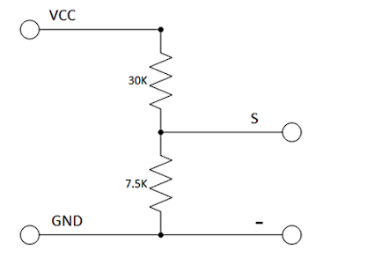
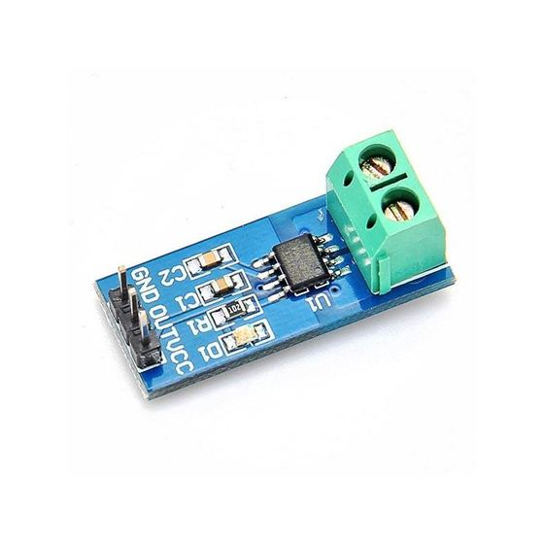
Voltage and Current Sensor
1
Voltage Sensor
2
Current Sensor

Slide 8
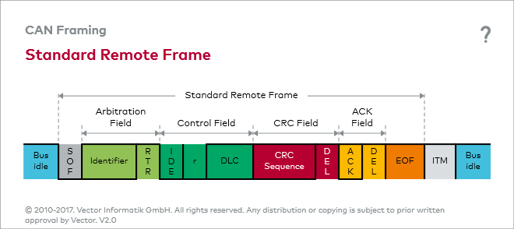
CAN Data Frame

Slide 9
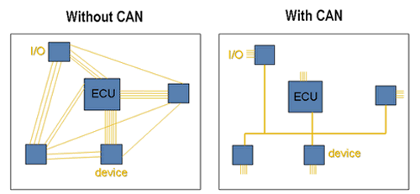
Why CAN ?

Slide 10
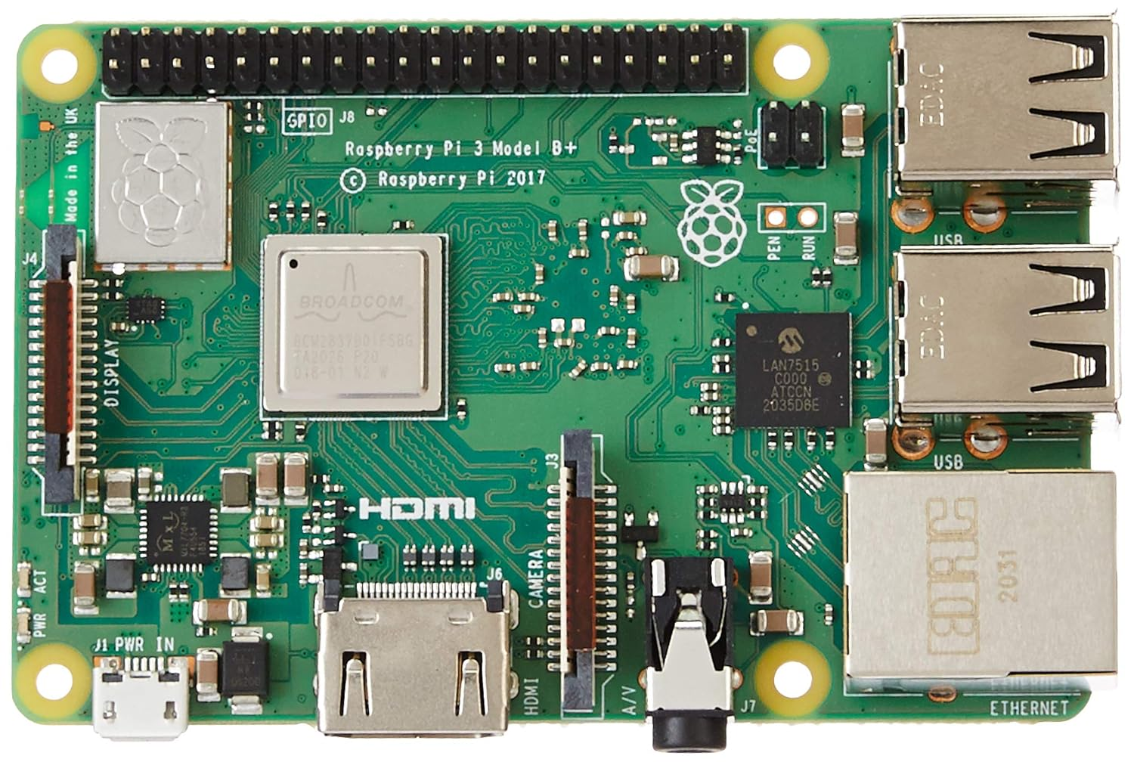
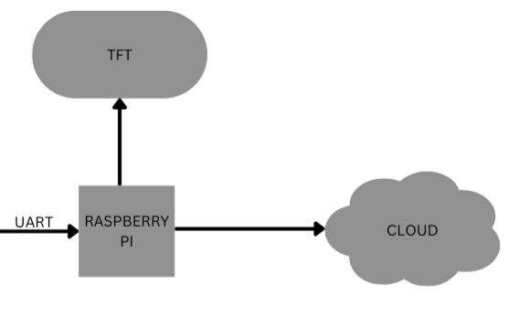
RASPBERRY PI 3 B+ Cloud and TFT

Slide 11
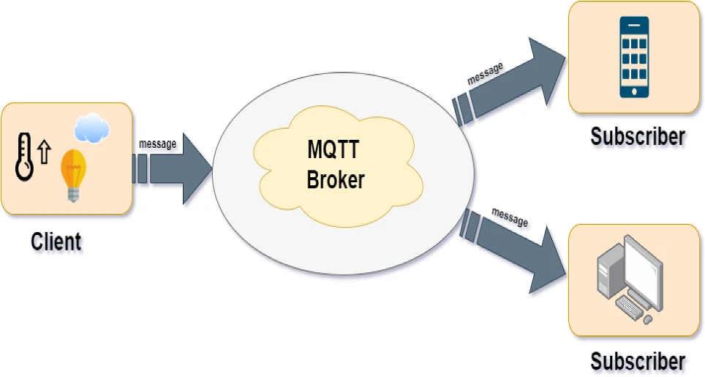

Slide 12
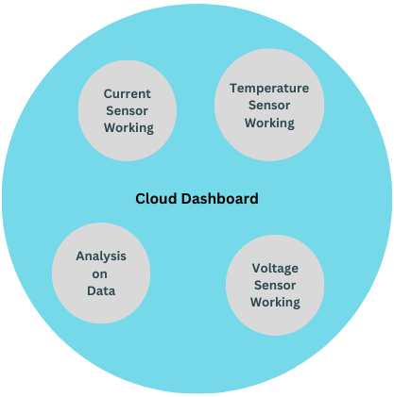
BRINGING IT ALL TOGETHER

Slide 13

THANK YOU

